Slide 1
Case Study I1: Talent and Income
Neil Benson

Slide 2
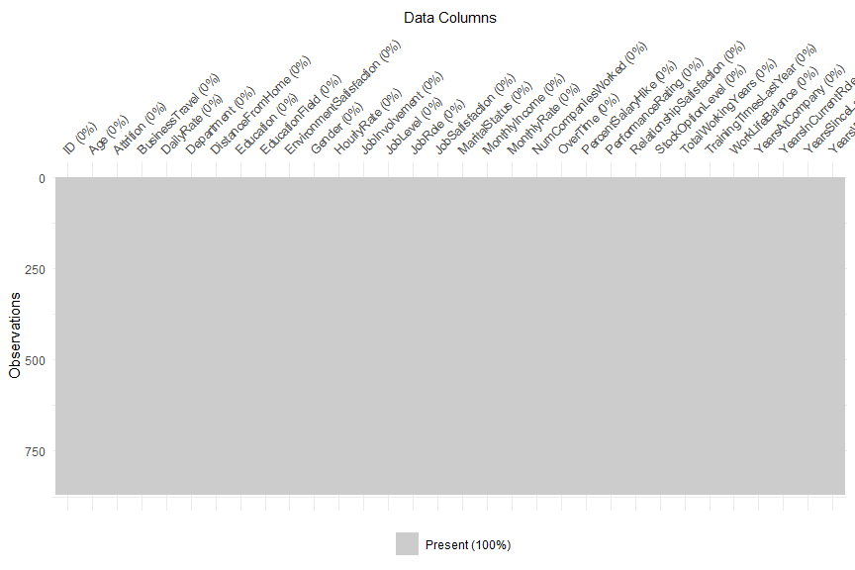
Cleaning the Data
As there weren’t any missing data, nor any columns with anything out of the ordinary, we did not cleanse or impute data

Slide 3
Profile of Attrition
Profile of Attrition:
Median Age: 32
Department: Research & Development
Education Field: Life Sciences
Gender: Men
Job Role: Sales Executive
Marital Status: Single
Median Years at Company: 3
Median Total Working Years: 6.5
Median Monthly Income: $3,171
Median Distance from Home: 9

Slide 4
Job Role Specific Trends
Job Role | Avg Job Satisfaction | Avg Monthly Income | Avg Total Working Yrs | Avg Yrs At Company | Avg Yrs In Current Role | Avg Yrs Since Last Promotion | Avg Yrs w/ Curr Manager
Healthcare Representative | 2.83 | $7,435 | 14 | 9 | 5 | 3 | 5
Human Resources | 2.56 | $3,285 | 6 | 5 | 3 | 1 | 3
Laboratory Technician | 2.69 | $3,222 | 8 | 5 | 3 | 1 | 3
Manager | 2.51 | $17,197 | 25 | 14 | 6 | 4 | 6
Manufacturing Director | 2.72 | $7,505 | 12 | 8 | 5 | 2 | 5
Research Director | 2.49 | $15,750 | 21 | 10 | 6 | 3 | 6
Research Scientist | 2.80 | $3,259 | 8 | 5 | 3 | 2 | 3
Sales Executive | 2.73 | $6,892 | 11 | 8 | 5 | 3 | 5
Sales Representative | 2.70 | $2,653 | 4 | 3 | 2 | 1 | 2

Slide 5
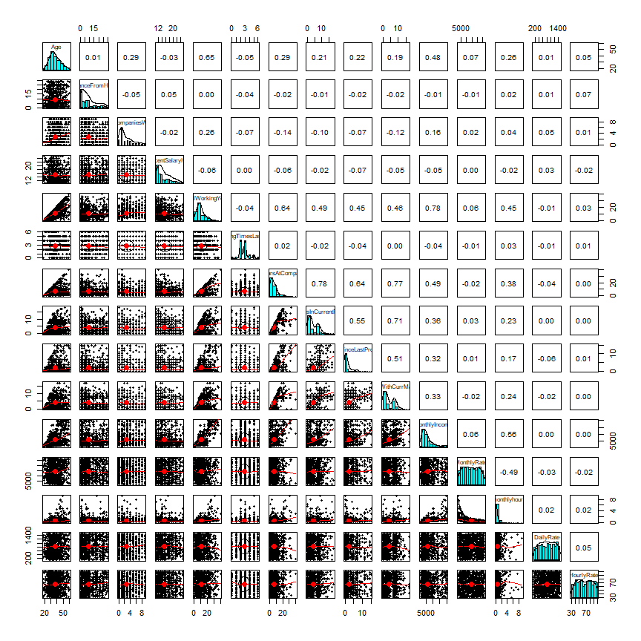
Colinearity
We observe mostly non-linear correlations between predictors, with some showing skewness

Slide 6
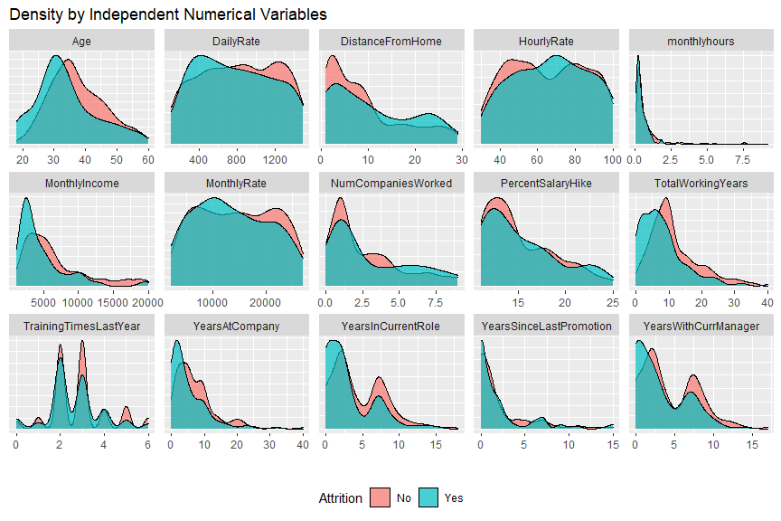
Density of numerical predictors
When looking at the overlap of density, monthly hours, training time last year, and years since last promotion do not seem to uniquely identify individuals who might attrition

Slide 7
most influential predictor factors for attrition
• OverTime
– pvalue: < 8.45e-13
• JobInvolvement
– pvalue: < 2.92e-06
• JobLevel
– pvalue: 0.00108

Slide 8
MODEL OPTIMIZATION
Attrition Model:
Attrition ~ JobInvolvement + JobSatisfaction + MaritalStatus + NumCompaniesWorked + OverTime + StockOptionLevel + YearsSinceLastPromotion + JobLevel + TotalWorkingYears + YearsWithCurrManager
Accuracy Sensitivity Specificity
0.7857143 0.7826087 0.7894737
Income Model:
MonthlyIncome ~ Age + BusinessTravel + JobLevel + Education + TotalWorkingYears
Multiple R-squared Adjusted R-squared RMSE
0.9278 0.9246 1187.83

Slide 9
Thank you!
Neil Benson

Slide 10
LINKS
Repository – https://github.com/bensonnd/msds/tree/master/ds6306/CaseStudy2DDS
Neil YouTube Video - https://youtu.be/nq0T1Pjn4ZI
Prediction Data Located at:
https://github.com/bensonnd/msds/tree/master/ds6306/CaseStudy2DDS/data
Case2PredictionsBenson Attrition.csv
Case2PredictionsBenson Salary.csv
Code Located at:
https://github.com/bensonnd/msds/tree/master/ds6306/CaseStudy2DDS/code
Knit/HTML Located at:
https://github.com/bensonnd/msds/tree/master/ds6306/CaseStudy2DDS/html

